Slide 1
INTRO: Aid Room Module Senior Program
Jodie Jeffers, Patroller Advisor, PNWD
jodie.jeffers@nsp-pnwd.org

Slide 2
Who’s Here Today?
Name
Division
Patrol
P/A/N/B
Sen ARM
Year taken
Senior **
Year comp.

Slide 3
Powderfall 2024
Name | Division | Patrol | P/A/N/B | ARM | CompYr | Senior*
Jodie Jeffers | Pacific NW | Santiam Pass | Patroller | Y - Instr | 2008 | 2008
Deb Wright | Intermtn | Kelly Canyon | Alpine | No
Debbi Satterlee | Eastern | Gore Mtn | Alpine/Bike | Yes | 2023
Gary Johnson | Eastern | Spring Mtn | Alpine | No
James Quinn | Rocky Mtn | Mt Crescent | Alpine/Bike | Yes | 1991 | 1991
Charlie Rose | Central | Mt Holly | Alpine/Bike | Taking now
Mark Ferreira | Far West | Dodge Ridge | Alpine | No
Lisa Rabideau | Eastern | Titus Mtn | Patroller | Taking now
Deborah Sheehan | Eastern | Gore Mtn | Alpine | Taking now
Greg Turk | Eastern | Spring Mtn | Alpine | Taking now

Slide 4
Just to Clarify
Overview
Non Registered Class
Discussion & Hands On Scenarios
Website NSP & Manual
NOT repeat of OEC- Inside
……disclaimer/updates/etc
Notes:
This is an overview, not an actual class.
Focusing on Leadership Skills and gaining awareness of your area and networking with them.

Slide 5
Notes:
Committee from multiple divisions worked on this guide, Kathy Lee was chair. Approved by the OEC Division leads. Was on website –prev version and NSP office advised they would upload it. In meantime, can access at PNWD’s site.

Slide 6
AR-MSP PURPOSE
REQUIRED COMPONENT
For the NSP Senior Patroller Candidates
Elective for Alpine/Nordic
Involves Five Demonstrating Areas*

Slide 7
Senior Information/Background
Seniors (Ski Patroller Manual).. Updated
NSP P&P Lastest Appendix D…..
Appendix G Skills Development Program….Core Modules
OEC Module of the Senior Program (P/A/N)
Senior Patroller- Aid Room Module (ARM)
It is Core for Patroller- Elective for Alpine
Notes:
AR-MSP

Slide 8
ARM…. Background
Seniors (Ski Patrollers Manual)
Committee from Various Divisions
OEC Supervisors, Patroller Leaders
Under Education, Seniors…OEC…
Final Guide Created for Candidates 2018
Resource for Instructors.
Notes:
AR-MSP

Slide 9
NSP Website….updating
NSP.ORG
STEPS…..
NOTE CORRECTIONS IN PROCESS
INCLUDING THE 2018 GUIDE/MANUAL
Notes:
AR-MSP. Website needs upload. The Guide needs to be current with post COVID, a few terminology, Wellness to scenarios….. Become a 6th criteria?

Slide 10
AR-MSP MISSION STATEMENT
Opportunity to demonstrate a global expertise in the operation of the Aid Room and care of patients.
Notes:
Leadership!! Networking…

Slide 11
AR-MSP GOAL
Enhance candidates skills & knowledge of aid room procedures & related area policies
Leadership, Decision Making, & Problem Management
While enhancing EXISTING OEC aid room skills
Prepares for leadership roles in NSP

Slide 13
Aid Room Module Senior Program
Candidate: What’s Next?
Who do they contact?
Questions? Now what?
Division OEC Supervisor or Designee

Slide 14
Aid Room Module Senior Program
Patroller Candidate:
Understand Goals & Objectives of this Module
Region OEC Administrators (ROA) - Questions
Division OEC Supervisor or Designee - Questions

Slide 15
Aid Room Module Senior Program
Senior Training Coordinators (STC)
Manages the program for the Region
Trainer/Evaluator (T/E)
Instructor Trainer (IT) Final Evaluation

Slide 16
Aid Room Module Senior Program
In person
Emails / Zoom
The Aid Room at their area….Mgmt +

Slide 17
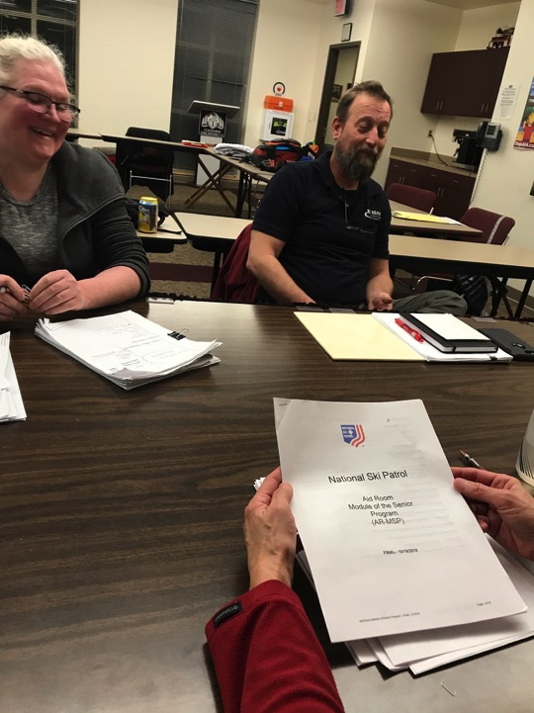

Slide 18
Candidate Checklist (App B)
Written Assignments/Exercises (3 Requirements)
Discussion of Assignments
Demonstrates/Discuss Five Topics and Objectives

Slide 19
Candidate Checklist (App B)
Written Assignments/Exercises (3 requirements)
1. Activity for Aid Room Design & Flow Process
2. Completion of Assignment Check List
3. Written Responses to minimum of 2 scenarios
All topics should be covered in written & assignment check list

Slide 20
Candidate Checklist (App B)
Discussion of Assignments
Demonstrates/Discuss Five Topics and Objectives

Slide 22
Candidate Checklist (App B) Five Main Areas D/D
1-Aid Room Triage & Resource Management
2-Medical Interventions & Treatment in Aid Room Environment
3-Conflict Resolution

Slide 23
Candidate Checklist (App B) Five Main Areas D/D
4-Interaction with EMS & Medical Personnel, Police, Other governmental agencies
5-Interfacing /Communication with Patrollers on scene & in Aid Room, Area Management
Notes:
???? Have a 6 for Wellness?? Also COVID/Infection enhanced version

Slide 24
Candidate Checklist (App B)
A- Activity for Aid Room Design and Flow Process
Outline of room, labeling
Aid Room Design & Flow Process Form (app c)
B- Assignment Check List (app d)
C- Written Responses
Min 2 Scenarios provided by T/E
Notes:
Report of missing person
❑ ?Employee injury while on duty and needs treatment
❑ ?Employee injury while NOT on duty and now needs treatment
❑ ?Requesting ground ambulance, required information to relay, and transfer of patient care
❑ ?Requesting air ambulance, required information to relay, and setting up landing zone (LZ)
❑ ?Replacement of equipment that is sent with the patient
❑ ?Consent for treatment of a minor age patient
❑ ?What is considered mandatory reporting (legal)
❑ ?Infection control policy

Slide 25
Candidate Checklist (App B)
Completion of minimum 2 practice scenarios
Completion of 2 scenarios at Final Evaluation
Note OEC Division Supervisor to supply scenarios (p/f)

Slide 26
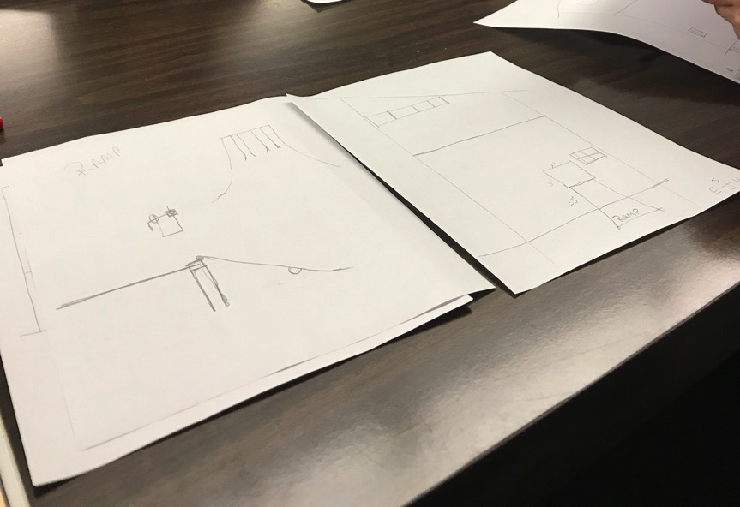

Slide 27
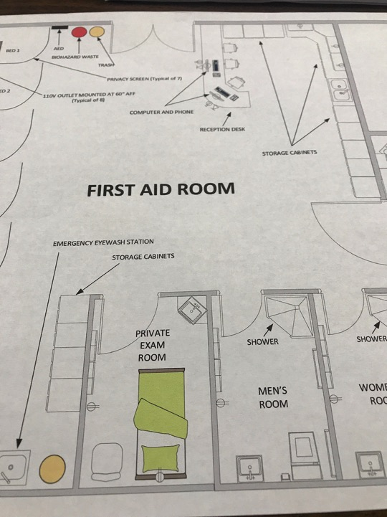

Slide 28
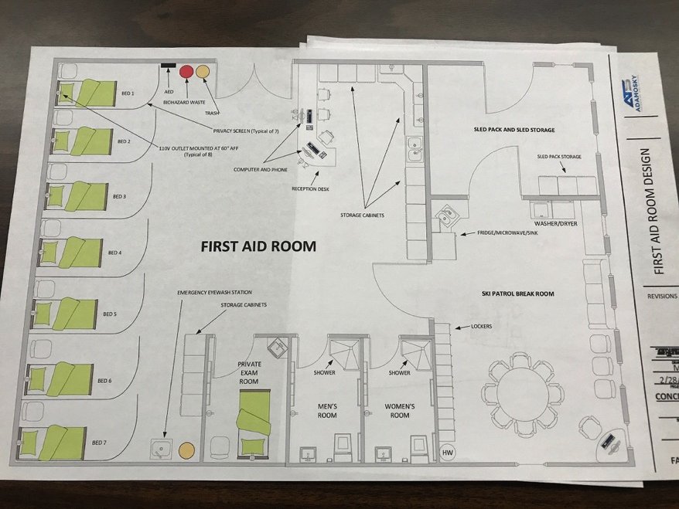

Slide 29
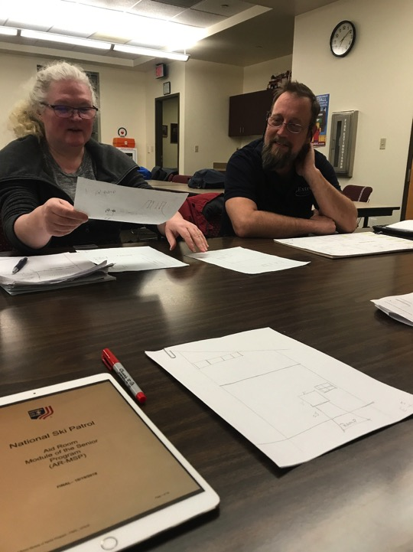
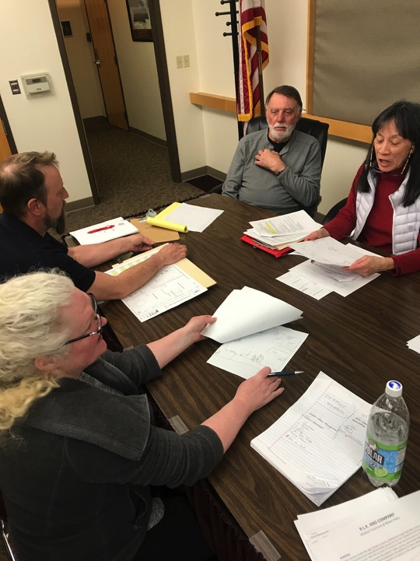

Slide 30
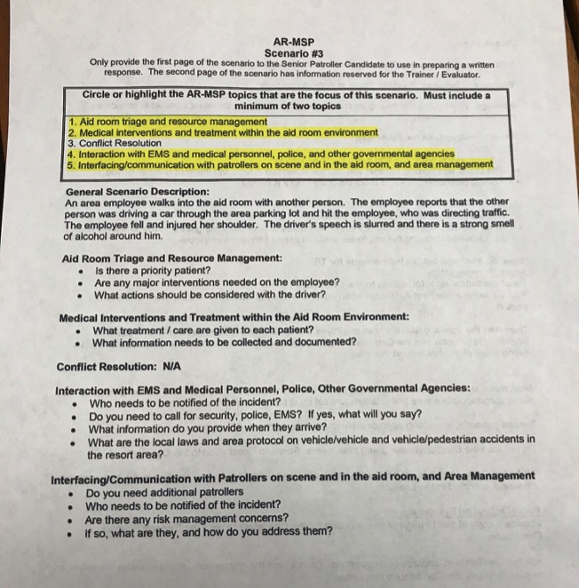

Slide 31
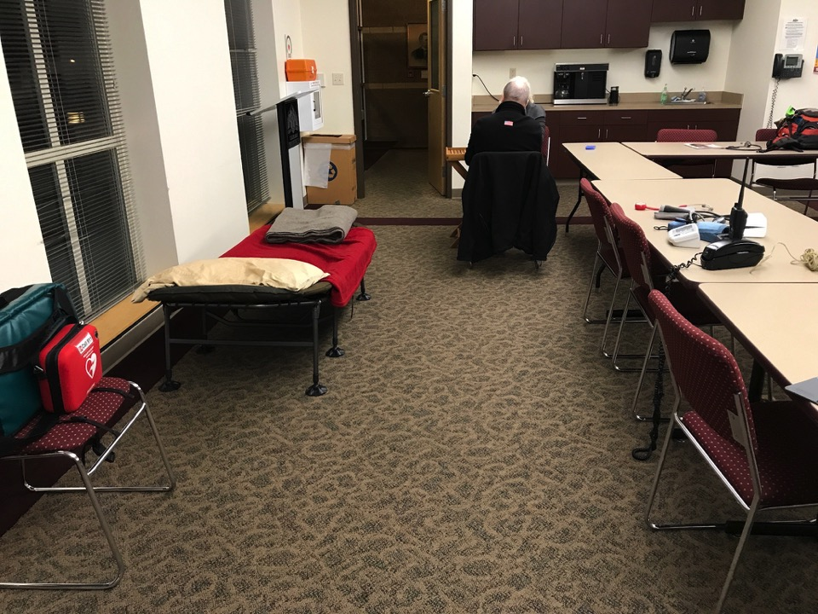
Notes:
Not a lot of supplies needed

Slide 32
Candidate Checklist (App B)
A- Activity for Aid Room Design and Flow Process
Outline of room, labeling
Aid Room Design & Flow Process Form (app c)

Slide 33
HISTORY – What’s Yours?
Notes:
HISTORY

Slide 34
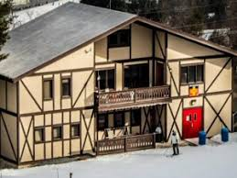
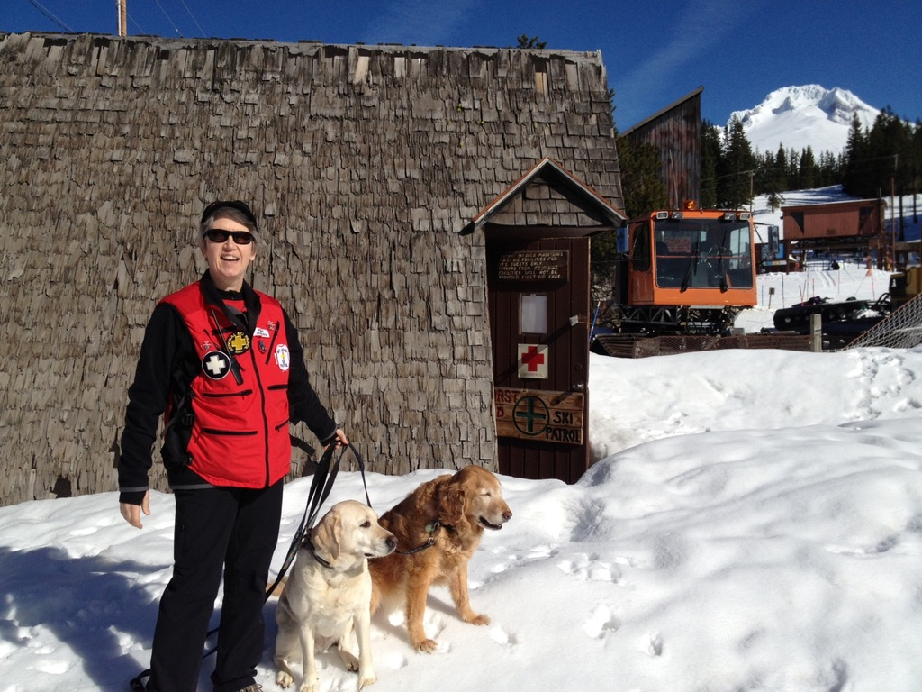
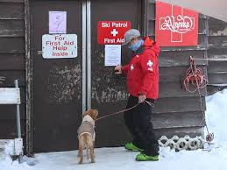
Blue Knob, Blue Mtn, Alyeska, Summit,

Slide 35
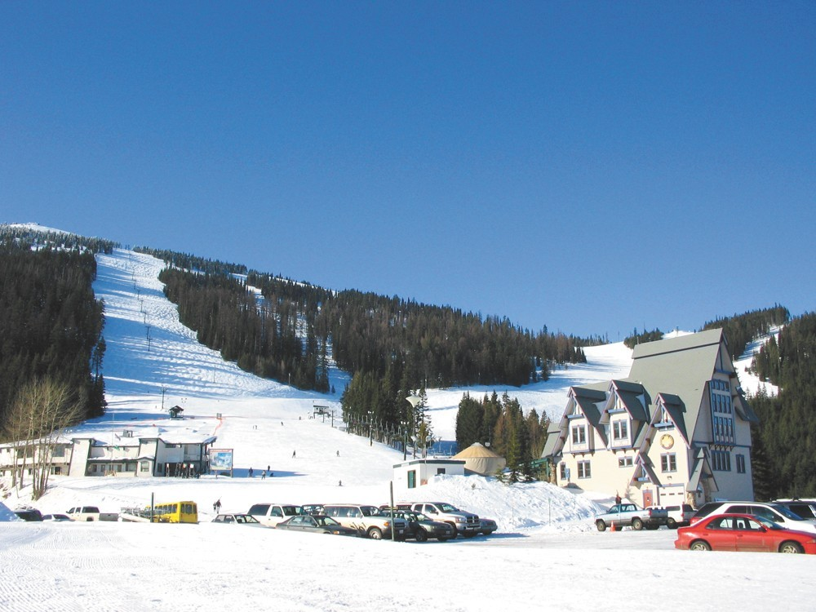
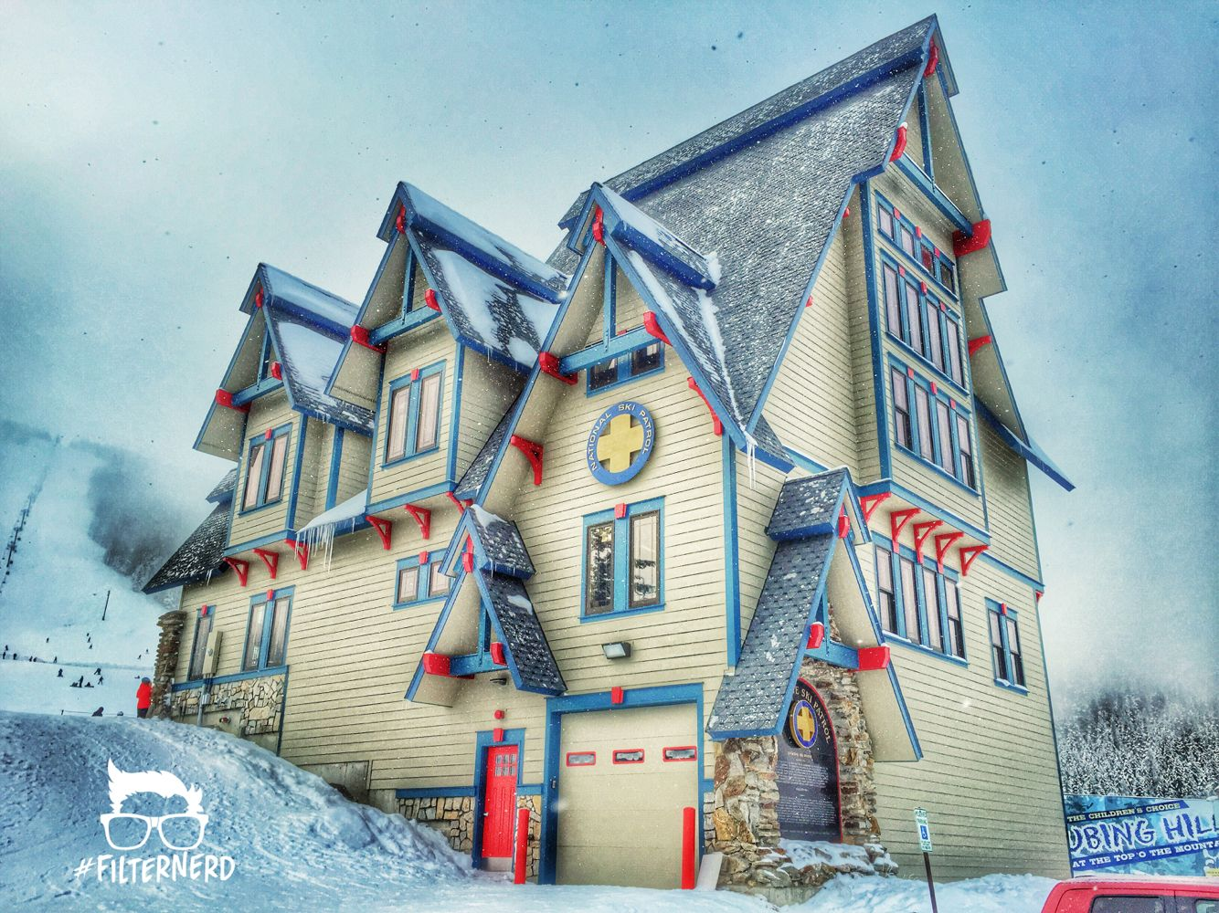
Mt Spokane

Slide 36
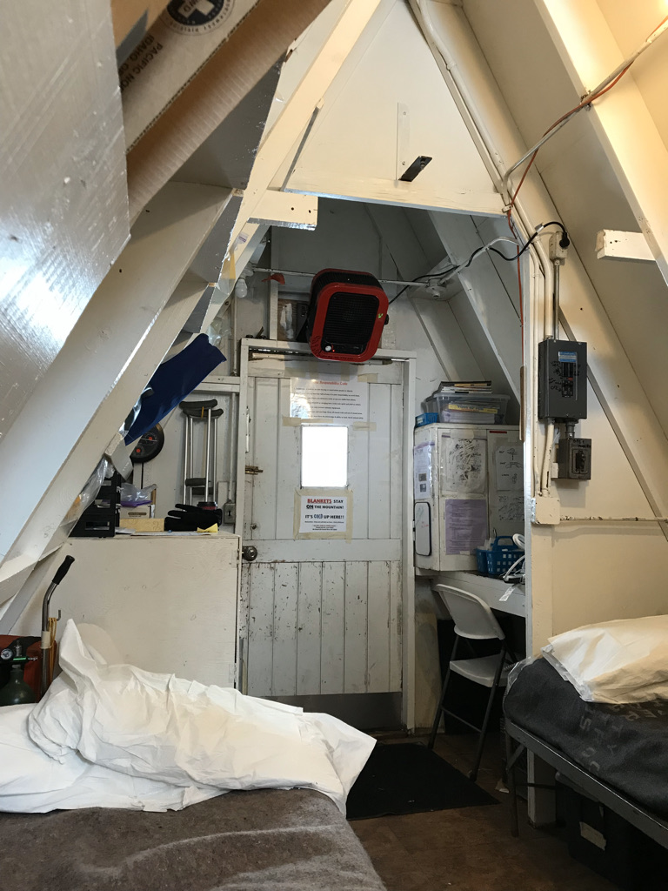
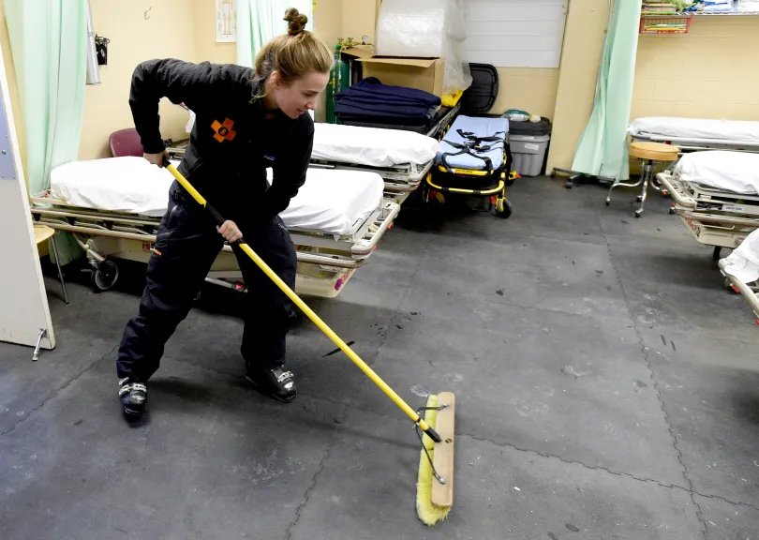
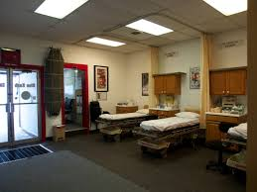
Inside
Eldora, Summit,
White Pass

Slide 37
Eldora, Summit,
Spokane, White Pass

Slide 38
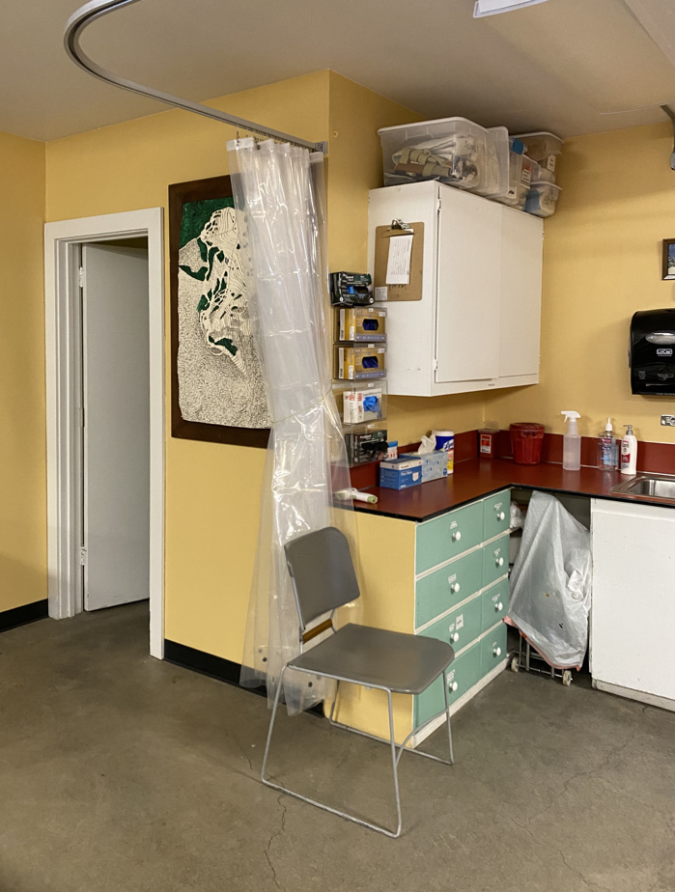
Santiam Pass- COVID Items

Slide 39
WOW!!

Slide 41
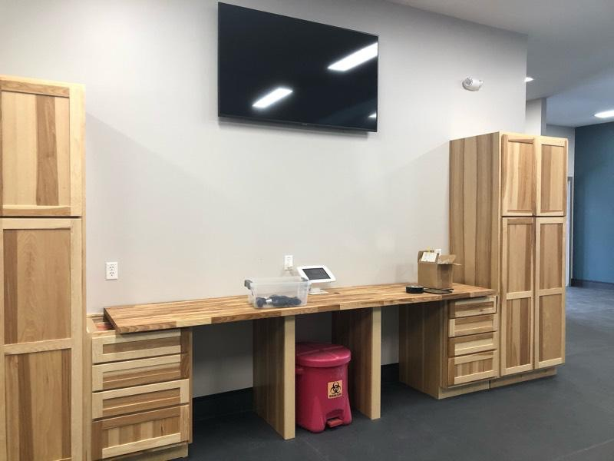

Slide 42
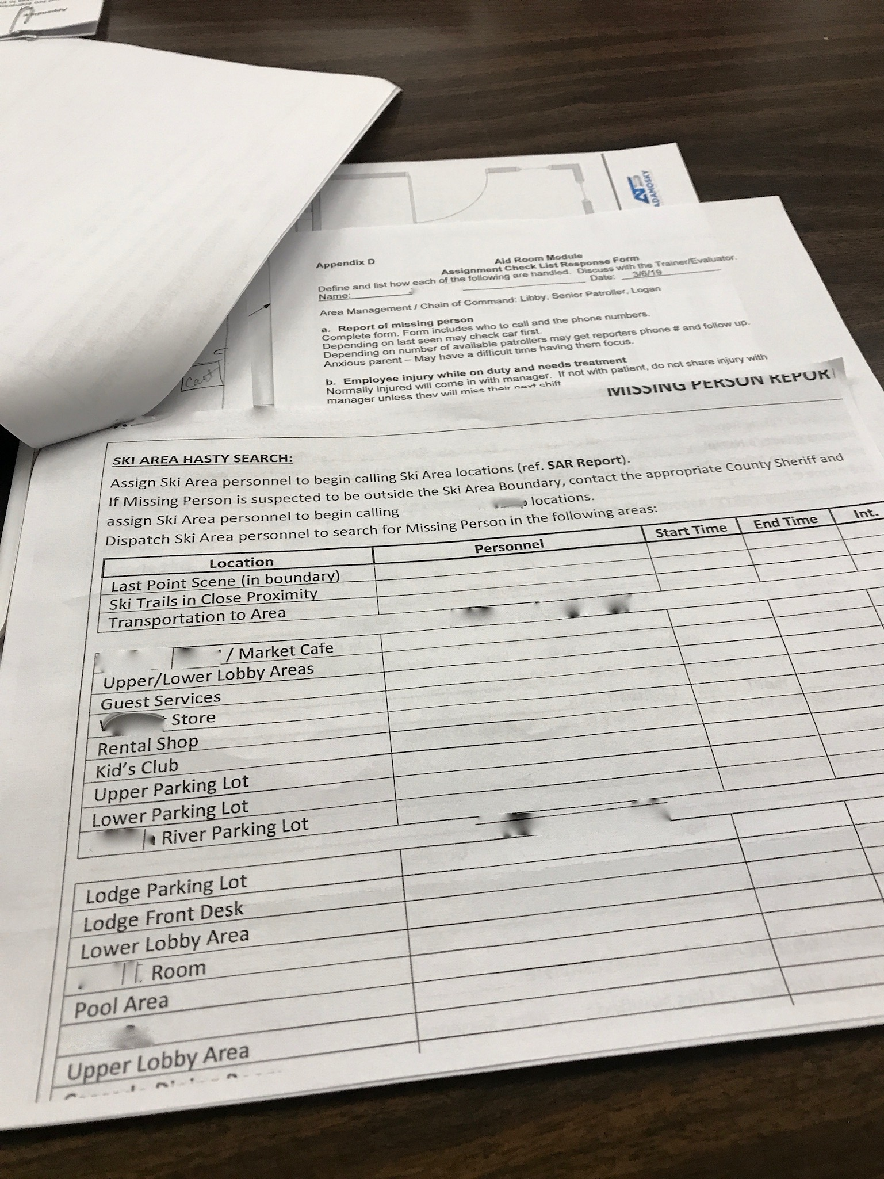
Notes:
Report of missing person
❑ ?Employee injury while on duty and needs treatment
❑ ?Employee injury while NOT on duty and now needs treatment
❑ ?Requesting ground ambulance, required information to relay, and transfer of patient care
❑ ?Requesting air ambulance, required information to relay, and setting up landing zone (LZ)
❑ ?Replacement of equipment that is sent with the patient
❑ ?Consent for treatment of a minor age patient
❑ ?What is considered mandatory reporting (legal)
❑ ?Infection control policy

Slide 45
MISSING PERSON(S)

Slide 46
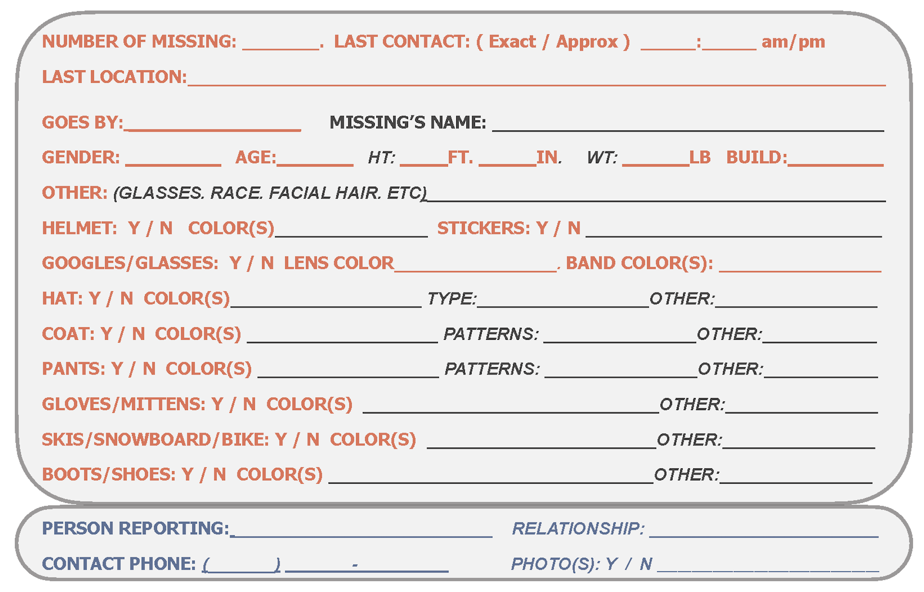

Slide 47
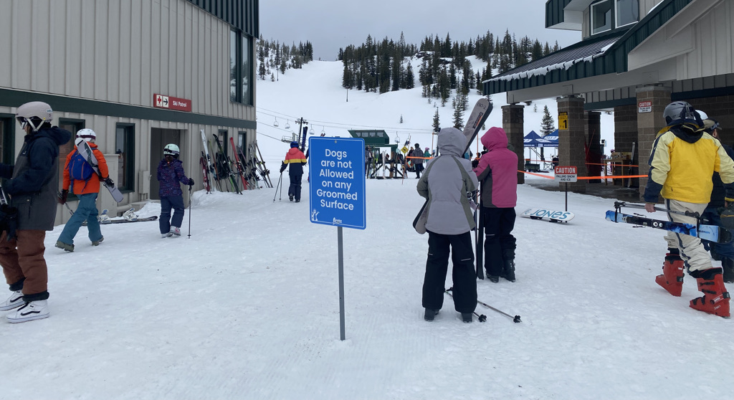
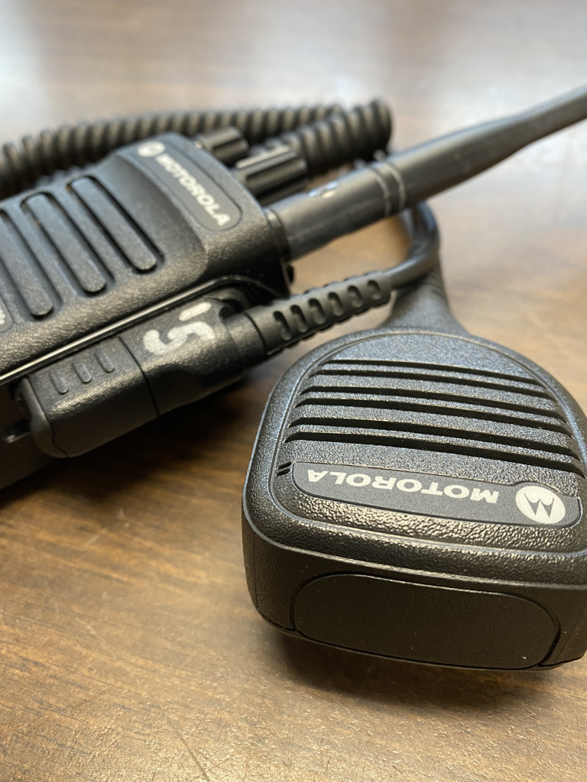
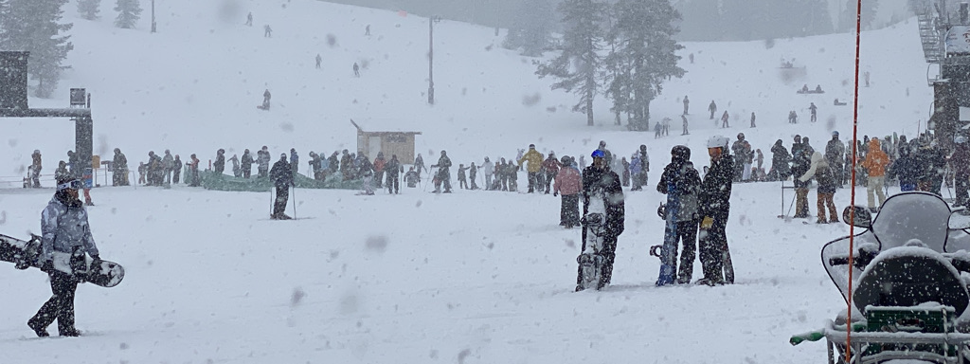
Missing Persons

Slide 48
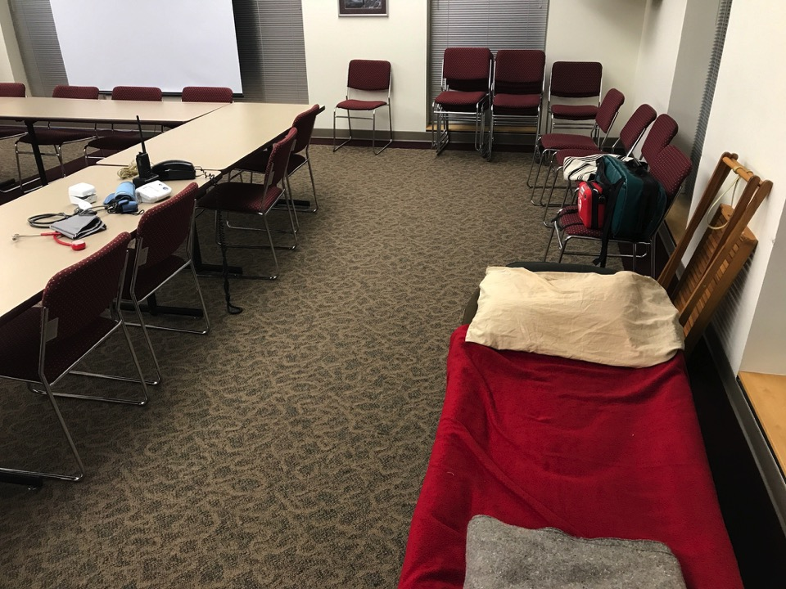

Slide 49
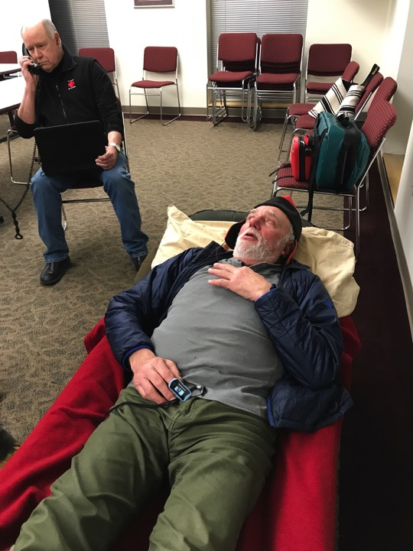

Slide 50
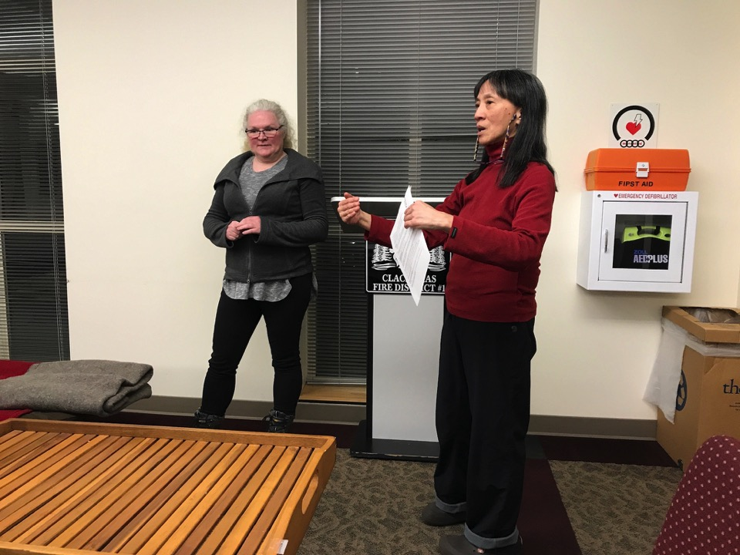

Slide 51
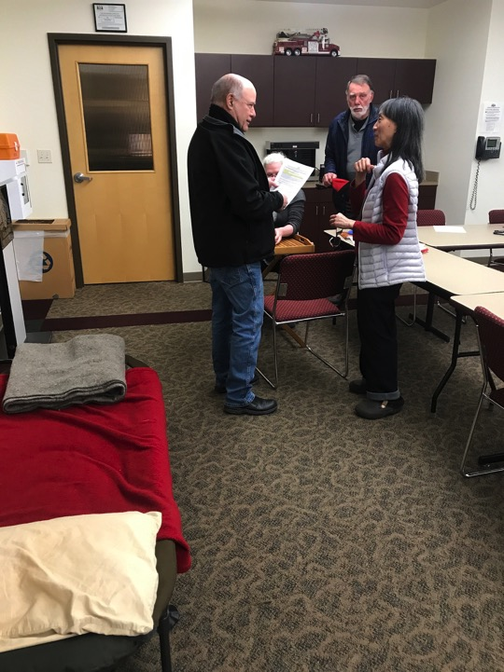

Slide 52
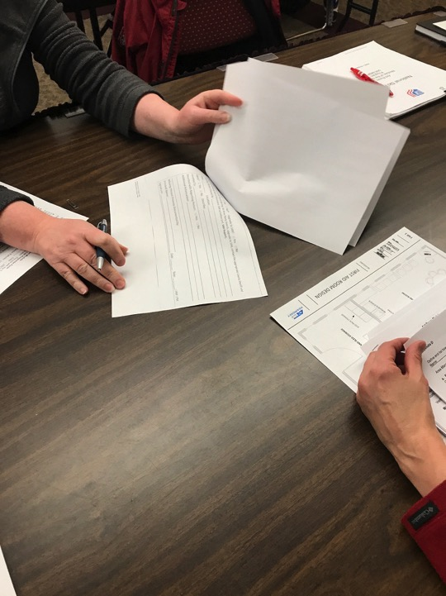

Slide 53
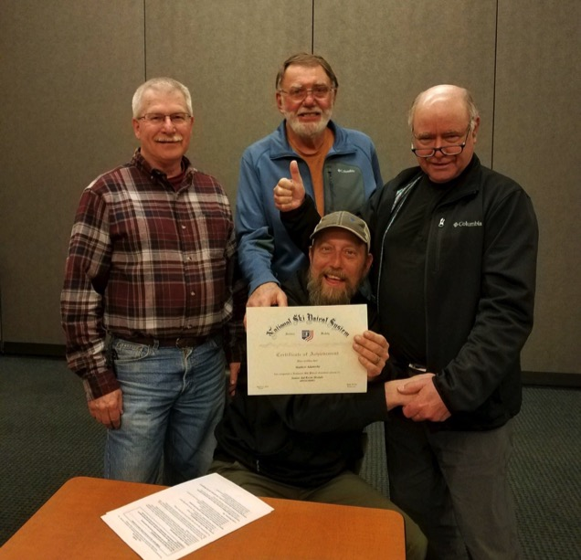

Slide 54
Aid Room Module Senior Program
You completed the Aid Room Module
……. now what?

Slide 55
Questions? Comments??
Jodie Jeffers, Patroller Advisor, PNWD
jodie.jeffers@nsp-pnwd.org

